Slide 1
Final Review
Eric Roberts and Chris Piech
CS 106A
March 14, 2010

Slide 2
Problem 1a—Practice #2
This problem is most easily solved if you think abstractly about what the program is doing:
public class Mystery extends ConsoleProgram {
public void run() {
int[] array = new int[13];
for (int i = 1; i <= 12; i++) {
for (int j = i; j > 0; j--) {
array[j] += j;
}
}
}
}
All arrays in Java are initialized to their default element, which is 0 for type int.
The outer loop runs for each value of i from 1 to 12.
The inner loop executes once for each value of j between 1 and i.
This is the only line that changes elements of the array, and it always adds j to the cell at index j. The question you need to figure out is how many times this happens.
Initial state:
State after first cycle of outer loop:
State after second cycle of outer loop:
State after third cycle of outer loop:
State after fourth cycle of outer loop:
State after fifth cycle of outer loop:
State after sixth cycle of outer loop:
State after seventh cycle of outer loop:
State after eighth cycle of outer loop:
State after ninth cycle of outer loop:
State after tenth cycle of outer loop:
State after eleventh cycle of outer loop:
State after twelfth cycle of outer loop:
0
0
0
0
0
0
0
0
0
0
0
0
0
0
1
2
3
4
5
6
7
8
9
10
11
12
0
0
2
4
6
8
10
12
14
16
18
20
22
0
0
0
3
6
9
12
15
18
21
24
27
30
0
0
0
0
4
8
12
16
20
24
28
32
36
0
0
0
0
0
5
10
15
20
25
30
35
40
0
0
0
0
0
0
6
12
18
24
30
36
42
0
0
0
0
0
0
0
7
14
21
28
35
42
0
0
0
0
0
0
0
0
8
16
24
32
40
0
0
0
0
0
0
0
0
0
9
18
27
36
0
0
0
0
0
0
0
0
0
0
10
20
30
0
0
0
0
0
0
0
0
0
0
0
11
22
0
0
0
0
0
0
0
0
0
0
0
0
12
0
0
0
0
0
0
0
0
0
0
0
0
0
1
1
1
1
1
1
1
1
1
1
1
1
1
2
2
2
2
2
2
2
2
2
2
2
2
2
3
3
3
3
3
3
3
3
3
3
3
3
3
4
4
4
4
4
4
4
4
4
4
4
4
4
5
5
5
5
5
5
5
5
5
5
5
5
5
6
6
6
6
6
6
6
6
6
6
6
6
6
7
7
7
7
7
7
7
7
7
7
7
7
7
8
8
8
8
8
8
8
8
8
8
8
8
8
9
9
9
9
9
9
9
9
9
9
9
9
9
10
10
10
10
10
10
10
10
10
10
10
10
10
11
11
11
11
11
11
11
11
11
11
11
11
11
12
12
12
12
12
12
12
12
12
12
12
12
12

Slide 3
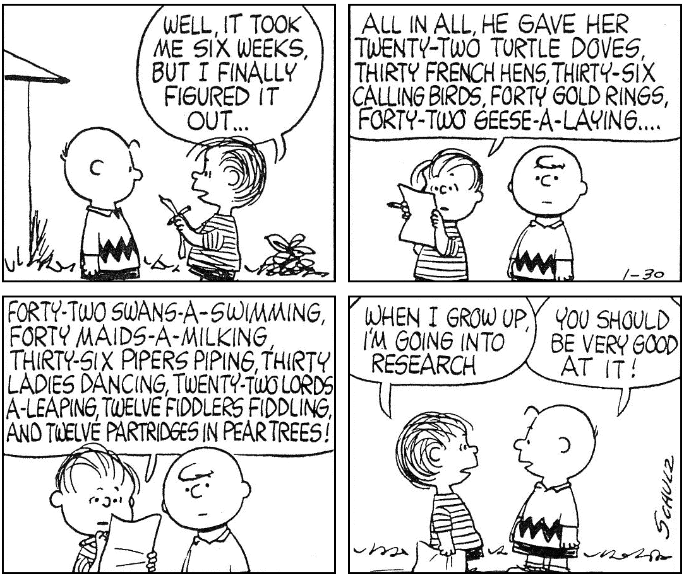
Problem 1a—Practice #2

Slide 4
Problem 1a—Practice #1
Sometimes, however, it is essential to be careful:
public void run() {
int[] list = { 10, 20, 30, 40, 50 };
mystery(list);
}
private void mystery(int[] array) {
int tmp = array[array.length - 1];
for ( int i = 1 ; i < array.length ; i++ ) {
array[i] = array[i - 1];
}
array[0] = tmp;
}
list
i
tmp
array
1
50
2
3
4
5
10
20
30
40
50
50
10
10
10
10
0
1
2
3
4

Slide 5
Problem 1b—Practice #1
private int[] insertValue(int value, int[] array) {
int[] result = new int[array.length + 1];
for (int i = 0; i < result.length; i++) {
result[i] = array[i];
}
int pos = 0;
for (int i = 0; i < array.length; i++) {
if (value > array[i]) {
pos = i;
break;
}
}
for (int i = result.length; i >= pos; i--) {
result[i] = result[i - 1];
}
result[pos] = value;
return result;
}
The length has to be the original array, not the expanded one.
If you don’t find a larger value, you want to add it at the end.
We should be looking for a larger value, not a smaller one.
This value is off by one. The loop needs to start at the last index.
This test is also off by one. The loop should stop before it hits pos.

Slide 6
Problem 1b—Practice #2
This syntax is inappropriate for the type char. You need to call the method Character.isLetter.
private String acronym(String str) {
String result = "";
boolean inWord = false;
for (int i = 0; i < str.length(); i++) {
char ch = str.charAt(i);
if (Character.isLetter(ch)) {
if (!inWord) result += ch;
inWord = true;
} else {
inWord = false;
}
}
return result;
}
private String acronym(String str) {
boolean inWord = false;
for (int i = 0; i < str.length(); i++) {
char ch = str.charAt(i);
if (ch.isLetter()) {
if (!inWord) result += ch;
} else {
inWord = false;
}
}
return result;
}
The variable result is undeclared and uninitialized.
The variable inWord is never set to true.

Slide 7
Problem 2 through 6
The Java problems are in the Eclipse project for this lecture.

Slide 8
Problem 7
Problem 7 is an essay question based on the assignments. Eric Roberts grades all the essays, assigns letter grades, and then converts them back to numeric scores in the 0-10 range. Criteria depend on the specific problem, but the quality of your exposition, the thoroughness and plausibility of your proposals, and whatever creativity you can bring to bear on the problem will all be taken into account.

Slide 9
Problem 7—Practice #1
Suppose that you have been asked to add a command
    ZAP object
that has the effect of returning the specified object to its initial room. Like LOOK, QUIT, INVENTORY, and the other action commands, the ZAP command can be executed in any room. Unlike the TAKE command, however, the object is not ordinarily in that room, but can be anywhere in the cave, including the player’s inventory.

Slide 10
Problem 7—Practice #2
Implement “superbricks” in Breakout.

Slide 11
Good Luck!

